Slide 1
Robotic Process Automation
Acctg & Fin | BUS AN 500 | Class 03
Spring Qtr | 2026

Slide 2

What will we do today?
Review
Robotic Process Automation
Introduction
Different Automation Models
RPA with UiPath Lab
Overview of the Cloud Interface
Starter Templates
Workshop/Lab time
Individual RPA Submission (30%)

Slide 3
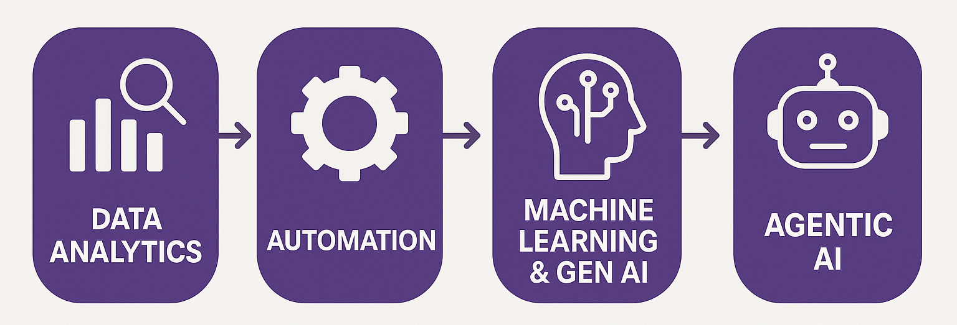
Course Diagram
Analytics workflows & pipelines

Slide 4
Course Diagram
Robotic Process Automation
(deterministic processes)

Slide 5
What will we do today?
Review
Robotic Process Automation
Introduction
Different Automation Models
RPA with UiPath Lab
Overview of the Cloud Interface
Starter Templates
Workshop/Lab time
Individual RPA Submission (30%)

Slide 6
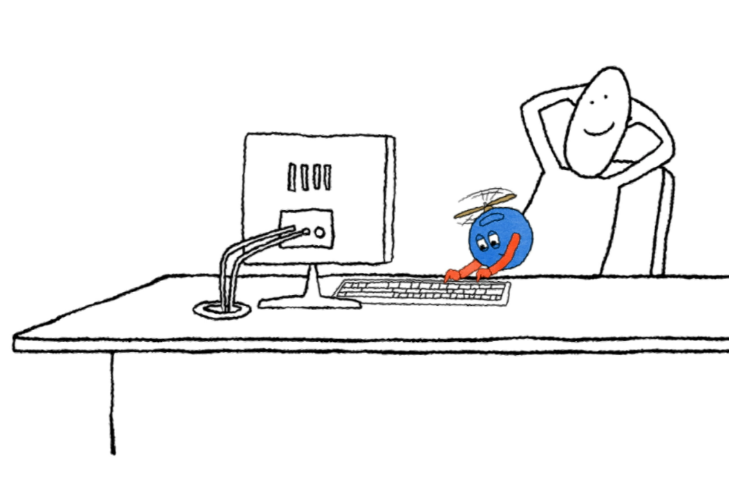

Poll everywhere
Name one day-to-day process that has made your life easier since it was automated.
Hints:
Automatic payments
Automatic door locks
Automatic elevators

Slide 7

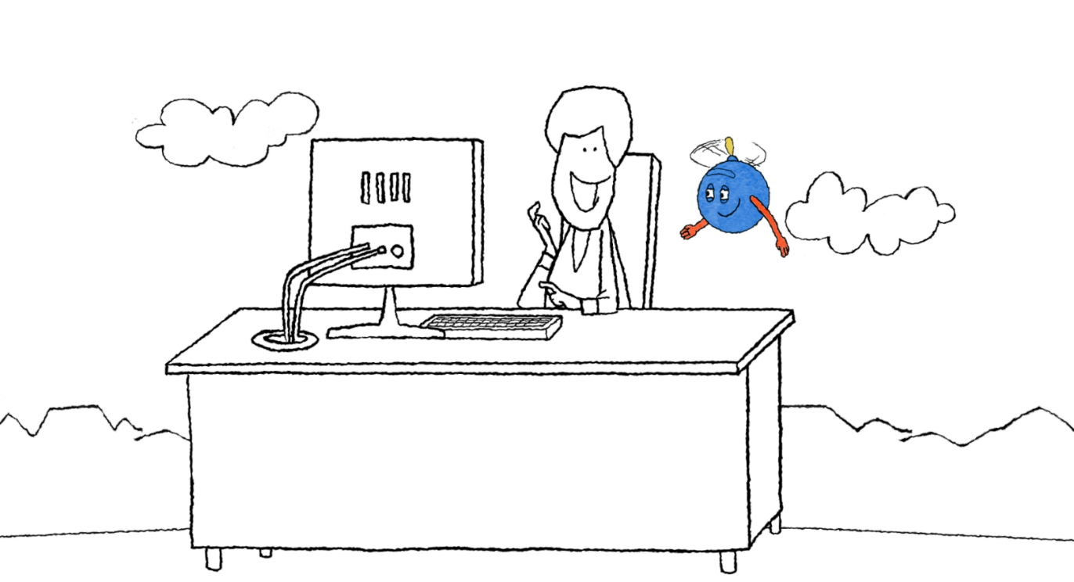

Automation…
Frees us to focus on essential work
Eliminates repetitive tasks
Leads us to more productive lives

Slide 8
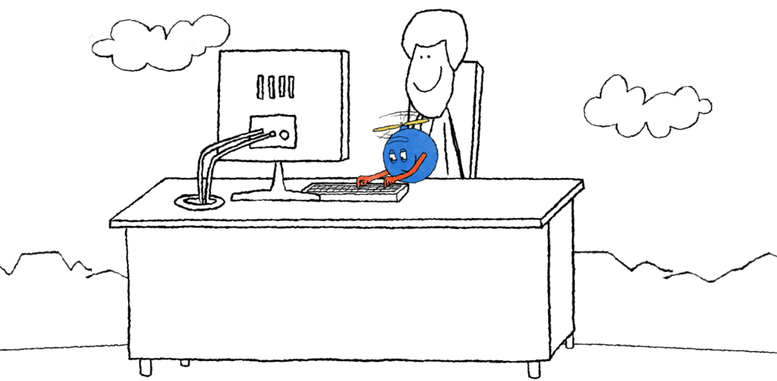
What is automation?
It involves leveraging technology, software, or machinery to carry out tasks.
It minimizes or eliminates the need for constant human intervention.
It allows processes to run smoothly and efficiently.

Slide 9
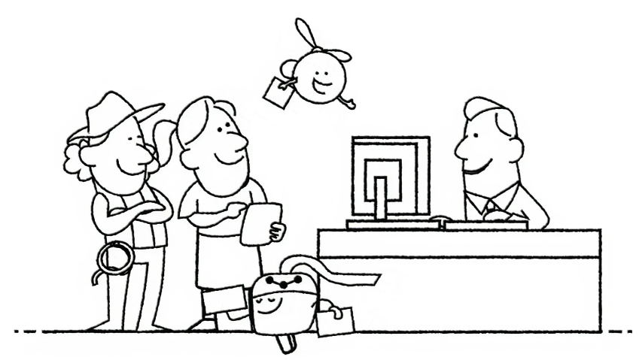
Why is automation such a game-changer?
It revolutionizes the way businesses and individuals operate.
It takes over repetitive tasks allowing employees to focus on more strategic and creative responsibilities,
leading to higher
job satisfaction.
It leads to increased efficiency and improved accuracy by reducing
human errors and streamlining processes.
It allows organizations to cut costs, enhance scalability, and provide 24x7 operations..

Slide 10


Automation categories
With UiPath, there are a bunch of automation categories that can help you get things done faster and easier!
Robotic Process Automation (RPA)
Test Automation
Task Automation
AI and Machine Learning Integration
Business Process Automation
Process Mining and Discovery

Slide 11

How can automation help me?
Here are four compelling reasons why automation can be a game-changer for your work life.
Job satisfaction
Enhanced opportunities
Skill development
Reduced stress

Slide 12
How can automation help my organization?
Here are six main reasons for your organization to embrace automation.
Saved cost
Enhanced compliance
Improved accuracy
Improved scalability
Increased efficiency
Optimized resource allocation

Slide 13






Common automation use cases
Let's explore six common examples of how automation can greatly benefit your work.
Payroll
processing
Client information
update
Contract
renewal
process
Financial
statement
reconciliation
Compliance
reporting
Customer
complaint
processing

Slide 14



Common automation use cases: payroll processing
Before
After
Extract details from handwritten
time sheets
Extracts details from handwritten
time sheets
Calculate pay from contracts
Calculates pay from contracts
Initiate the payment transaction
Initiates the payment transaction
Task Completed
Task Completed

Slide 15
Common automation use cases: client information update
Before
After
Update information from
various sources
Processes requests for information
in batches
Make frequent calls to the back-end databases to collect information
Extracts information from the back-end databases
Task Completed
Task Completed

Slide 16
Common automation use cases: contract renewal process
Before
After
Communicate with the client
Communicates with the client
Process the changes from the client
Processes the changes from the client
Draft the required documents
Drafts the required documents
Update the changes in
internal systems
Updates the changes in
internal systems
Task Completed
Task Completed

Slide 17

Common automation use cases: financial statement reconciliation
Before
After
Matches order, payment, losses, margins with accounts and
financial statements
Match order, payment, losses, margins with accounts and
financial statements
Records discrepancies, if any.
Record discrepancies if any.
Asks for human validation, if required.
Task Completed
Task Completed

Slide 18
Common Automation Use Cases: Compliance Reporting
Before
After
Monitors the requirements for
each department
Monitor the requirements for
each department
Follows the internal procedure and audit requirements
Follow the internal procedure and audit requirements
Follow-ups on the reporting
to authorities.
Follow up the reporting to authorities
Asks for human validation, if required.
Task Completed
Task Completed

Slide 19
Common automation use cases: customer complaint processing
Before
After
Receive complaint-related calls
from customer
Receives complaint-related calls
from customer
Categorize the customer complaint
Categorizes the customer complaint
Analyze the customer complaint
Analyzes the customer complaint
Suggest practical solutions to
the complaint
Suggests practical solutions to
the complaint
Task Completed
Task Completed

Slide 20
What will we do today?
Review
Robotic Process Automation
Introduction
Different Automation Models
RPA with UiPath Lab
Overview of the Cloud Interface
Starter Templates
Workshop/Lab time
Individual RPA Submission (30%)

Slide 21
Automation models
There are six automation models tailored to meet a broad spectrum of automation needs.
Model 1: Fully
Unattended
Model 4: Attended,
interval
Model 2: Partially Unattended
Model 5: Attended in tandem
Model 3: Human in
the loop
Model 6: Hybrid automation

Slide 22
1. Fully unattended: What it does
In this automation model, the unattended robot:
Launches automatically based on triggers
or schedules.
Is centrally managed by a workflow orchestrator
for 24x7 operation.
Executes the process consistently and alerts
exceptions if any.

Slide 23
1. Fully unattended: A real-life scenario
Collate all
relevant sales
data from
multiple systems
Aggregate
data
Check data
integrity and
quality. Pass
back exceptions
where required
Verify
data
Create and
send report

Slide 24
2. Partially unattended: What it does
In this automation model, the partially unattended robot can:
Take over scheduled tasks or upon your instruction.
Handle preparatory work and process initiation.
Program complex business rules.
Provide data validation and assurance.
Notify you only in case of exceptions.

Slide 25
2. Partially unattended: A real-life scenario
Collate all
relevant
appraisal
information
Trigger
automation
via keystroke
Review
appraisal
Order
appraisal
Gather
appraisal
information
Pass to
advisor

Slide 26
3. Human in the loop: What it does
In this model, the unattended robot can:
Initiate processes based on schedules or triggers.
Request your input when needed.
Resume the process after you've completed your task.
Repeat this cycle as required within the process.

Slide 27
3. Human in the loop: A real-life scenario
Scan the
paper-based
invoice
Trigger
automation
via keystroke
Check and
verify data
Trigger
automation
Check data
in the
invoice fields
Pass to ERP
system
Pass poor
quality data
to user

Slide 28
Automation models
There are six automation models tailored to meet a broad spectrum of automation needs.
Model 1: Fully
Unattended
Model 4: Attended,
interval
Model 2: Partially Unattended
Model 5: Attended in tandem
Model 3: Human in
the loop
Model 6: Hybrid automation

Slide 29
What will we do today?
Review
Robotic Process Automation
Introduction
Different Automation Models
RPA with UiPath Lab
Overview of the Cloud Interface
Starter Templates
Workshop/Lab time
Individual RPA Submission (30%)

Slide 30











UiPath Agentic Automation

Slide 31
What will we do today?
Review
Robotic Process Automation
Introduction
Different Automation Models
RPA with UiPath Lab
Overview of the Cloud Interface
Starter Templates
Workshop/Lab time
Individual RPA Submission (30%)

Slide 32
Task: Process Assessment tool
Run your idea through the process automation tool, make sure it is a good fit for RPA.

Slide 33
Submission checklist
Build your RPA solution in UiPath Cloud Studio Web
Save it as an *.uip or *uis file (the three vertical dot menu next to the solution, choose Download Solution)
Set up Zoom or other video software to record your video. Speak to the bot’s purpose and benefits on camera with you visible, run the bot with screen being captured showing the bot operating.
Discuss any inputs or outputs required for the bot.
Use Efficiency (hours saved) and effectiveness (errors avoided).
Save your video recording locally.
Download copies of anything required to run the bot (inputs etc).
Zip all the files together (UiPath solution file, video, inputs).

Slide 34
Thank you

